Slide 1


Data
http://www.datascience4all.org
Introduction to Computational Thinking and Data Science
Yolanda Gil
University of Southern California
gil@isi.edu
CC-BY
Attribution
ACI-1355475
Last Updated:
September 2016

Slide 2
Intended Audience
Designed for students with no programming background who want to have literacy in data and computing to better approach data science projects
Computational thinking: a new way to approach problems through computing
Abstraction, decomposition, modularity,…
Data science: a cross-disciplinary approach to solving data-rich problems
Machine learning, large-scale computing, semantic metadata, workflows,…

Slide 3

These materials are released under a CC-BY License
https://creativecommons.org/licenses/by/2.0/
You are free to:
Share — copy and redistribute the material in any medium or format
Adapt — remix, transform, and build upon the material
for any purpose, even commercially.
The licensor cannot revoke these freedoms as long as you follow the license terms.
Under the following terms:
Attribution — You must give appropriate credit, provide a link to the license,
and indicate if changes were made. You may do so in any reasonable manner,
but not in any way that suggests the licensor endorses you or your use.
Artwork taken from other sources is acknowledged where it appears.
Artwork that is not acknowledged is by the author.
Please credit as: Gil, Yolanda (Ed.) Introduction to Computational Thinking and Data Science. Available from http://www.datascience4all.org
If you use an individual slide, please place the following at the bottom: “Credit: http://www.datascience4all.org/”
As editors of these materials, we welcome your feedback and contributions.

Slide 4
Acknowledgments
ACI-1355475
These course training materials were originally developed and edited by Yolanda Gil (USC) with support from the National Science Foundation with award ACI-1355475
They are made available as part of http://www.datascience4all.org
The course materials benefitted from feedback from many students at USC and student interns, particularly Taylor Alarcon (Brown University), Alyssa Deng (Carnegie Mellon University), and Kate Musen (Swarthmore College)
We welcome new contributions and suggestions

Slide 5
Today’s Topics
What is “Data”
Accessible Data
Types of Data
Common Data Terms
A Practical Example: Collecting Field Data in Geosciences

Slide 6
1. What is Data

Slide 7

What is Data
Data is information that is processable by computer:
The information to be processed is in digital form
A program can read and analyze the information
https://www.flickr.com/photos/hellocatfood/10545396704

Slide 8
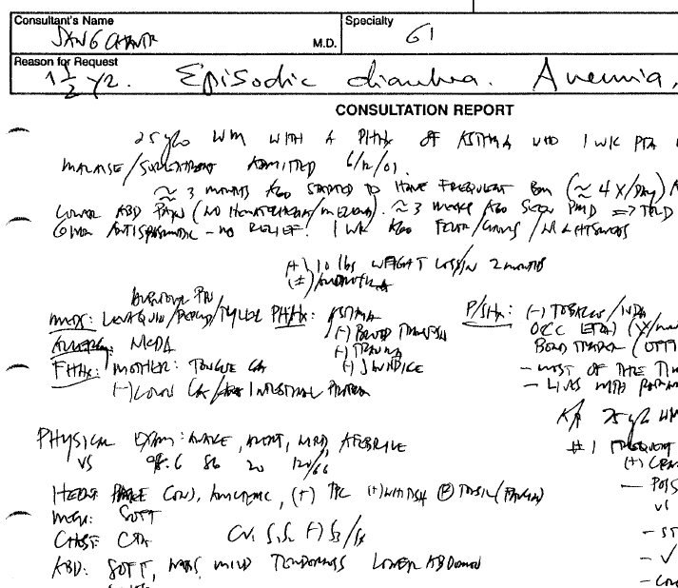
Is This Data?

Slide 9
Is This Data?
http://diyehr.com/making-your-electronic-health-records-searchable/

Slide 10
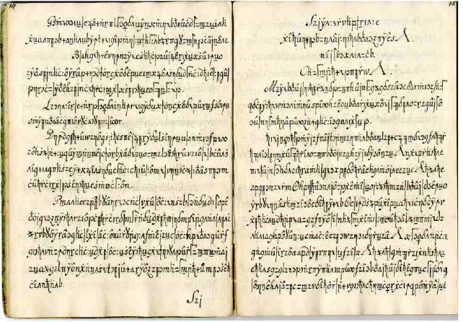
Is This Data?
http://stp.lingfil.uu.se/~bea/copiale/
Notes:
1760-1780

Slide 11
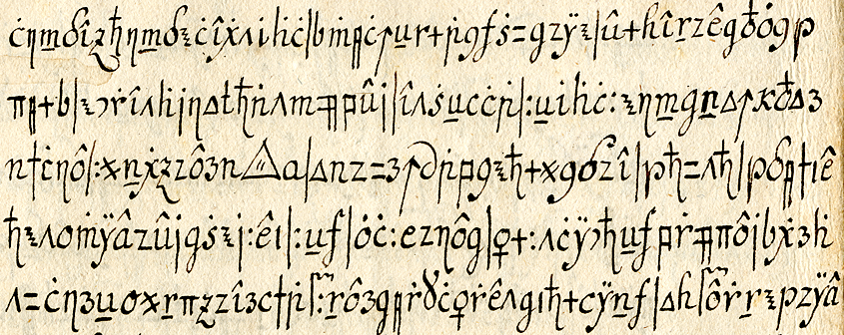
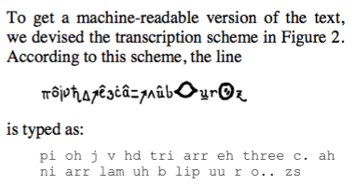
Is This Data?
http://stp.lingfil.uu.se/~bea/copiale/
Notes:
1760-1780

Slide 12
2. Accessible Data

Slide 13

Accessible Data
Data is accessible to you if:
You have the rights to access to the data
You know the procedure to obtain or use the data
Option 1: Locally
Option 2: Remotely
https://pixabay.com/en/data-key-key-close-close-to-lock-571156/

Slide 14
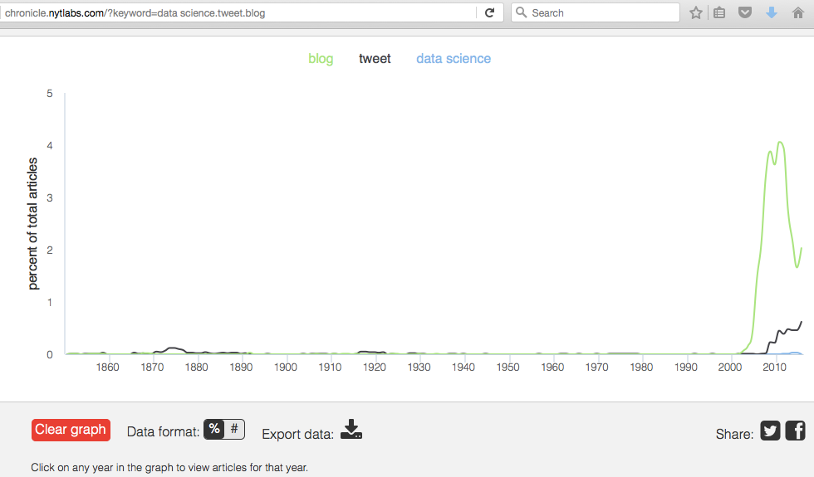
Manually Accessible Data
Accessible!
But note this (see next slide)

Slide 15
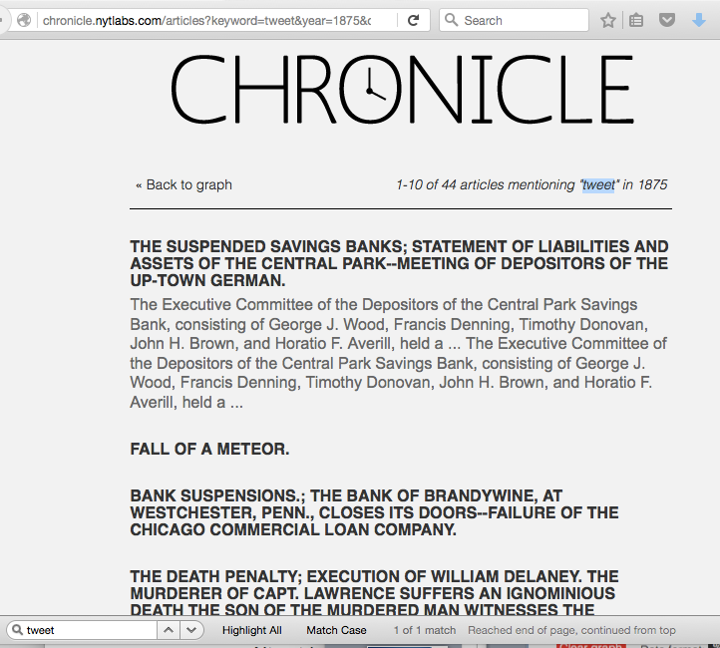
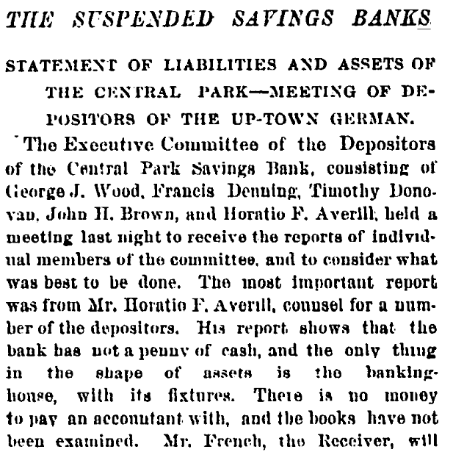
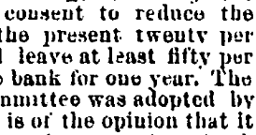

Slide 16
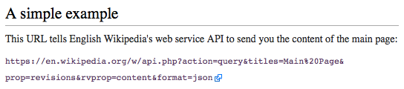
A Program Can Access Lots of Data Directly through an “API”
An API (Application Programming Interface) is a document that specifies what queries are possible and their format, and the format of the responses
Your application
Their data server
Give me
xyz data
Program
Data
API
Here is
that data
https://www.mediawiki.org/wiki/API:Main_page#A_simple_example

Slide 17

Accessibility of Medical Data
http://www.crimeoff24.com/?p=4869

Slide 18

Accessibility of Social Media Data
https://www.flickr.com/photos/epublicist/9733278939

Slide 19
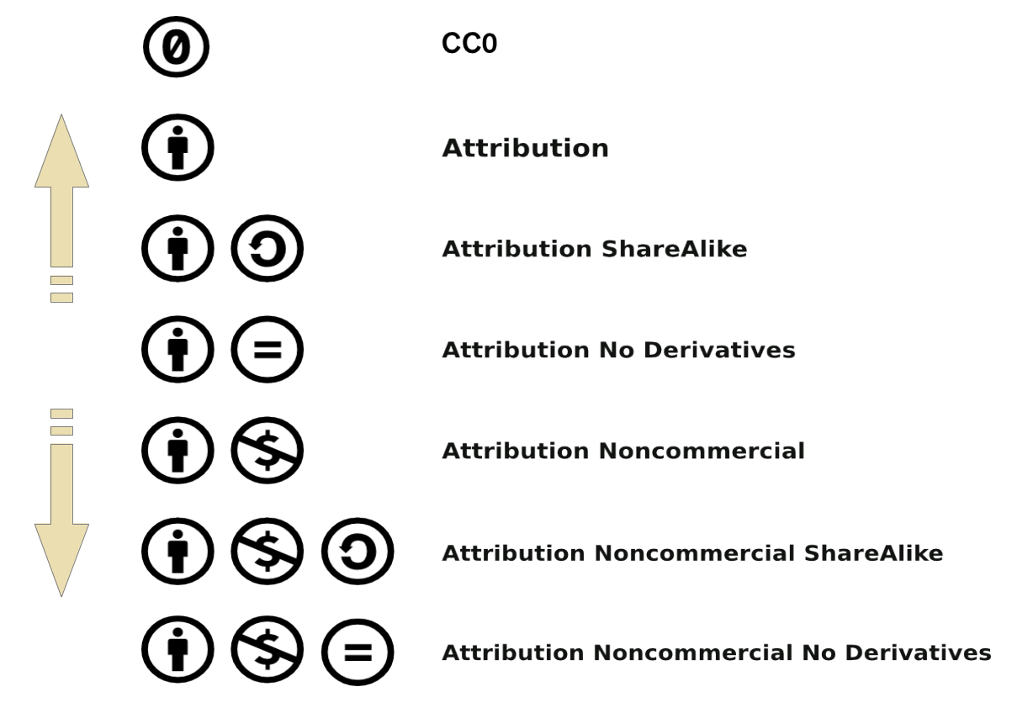

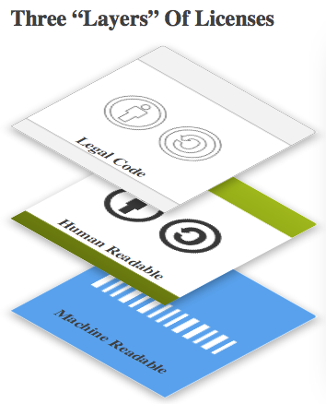
Licenses for Data (https://creativecommons.org/licenses/)

Slide 20
3. Types of Data

Slide 21

Many Types of Data
Tabular data
Time series data
Networked data
Geospatial data
Text data
Multimedia data
https://www.flickr.com/photos/rh2ox/9990024683

Slide 22
Tabular Data
Course ID | Faculty Name | Semester Offered | Open
549 | A. Gold | Fall 2015 | Yes
533 | D. Garcia | Fall 2017 | Open
556 | P. Peters | Spring 2015 | Y
521 | J. Smith | Spring 2015 | Open
IMPORTANT: Not a PDF or image, the individual cells must be accessible (eg you can load the table on a spreadsheet)

Slide 23
Time Series Data
2005-01-01 00:00:00,51,0
2005-01-01 01:00:00,44,0
2005-01-01 03:00:00,43,0
2005-01-01 04:00:00,44,0
2005-01-01 05:00:00,43,0
2005-01-01 06:00:00,46,0
2005-01-01 07:00:00,48,0
2005-01-01 08:00:00,50,0
http://www.texample.net/tikz/examples/weather-stations-data/

Slide 24
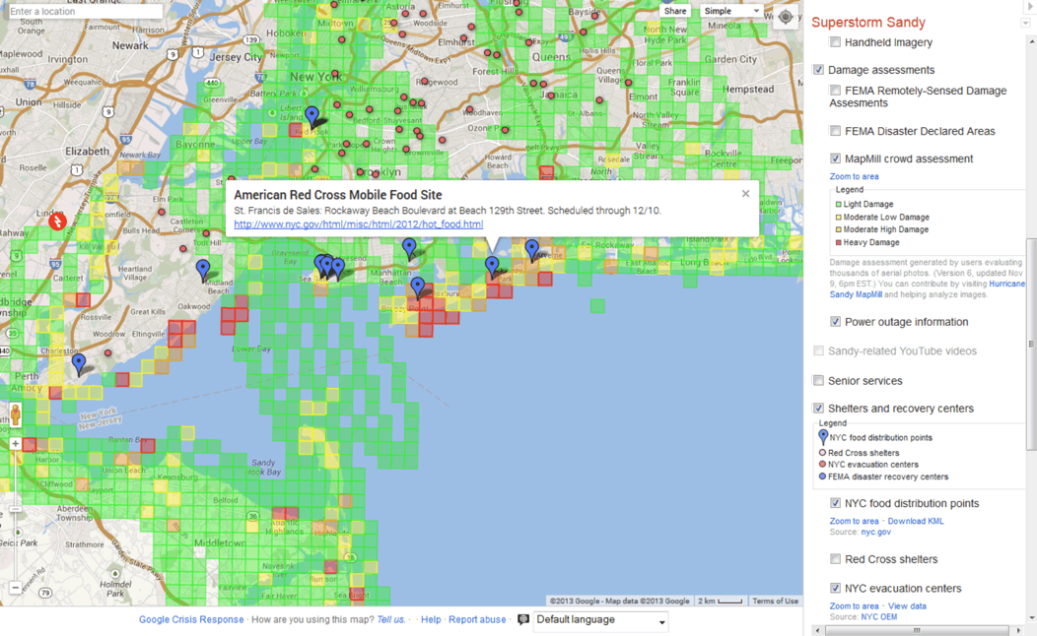
Geospatial Data
Fairfield Fire Station 2
-74.006393,40.714172,0
Shelter
Fairfield Central Park SW Entrance
-74.006387,40.714182,0
American Red Cross Mobile Food Site
https://www.e-education.psu.edu/geog588/l4_p5.html

Slide 25
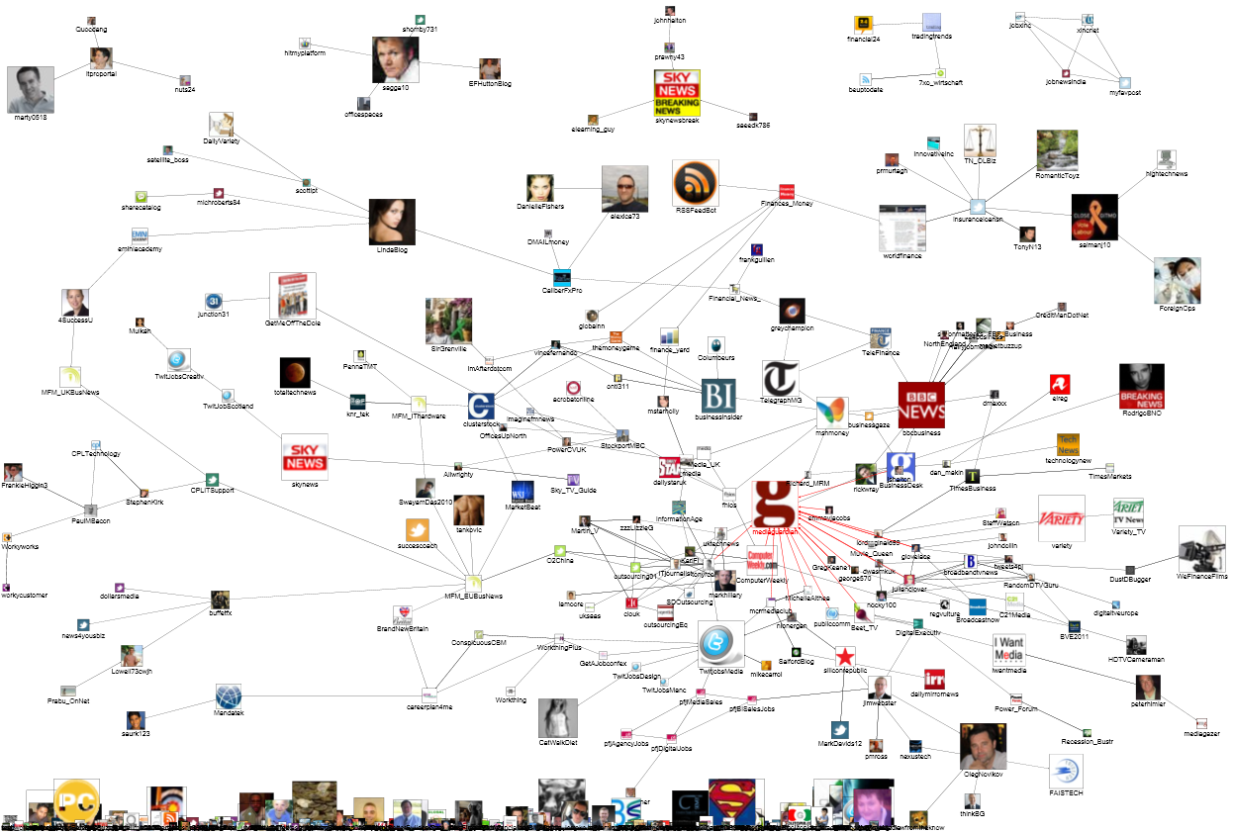
Network Data
https://www.flickr.com/photos/marc_smith/4512483812

Slide 26
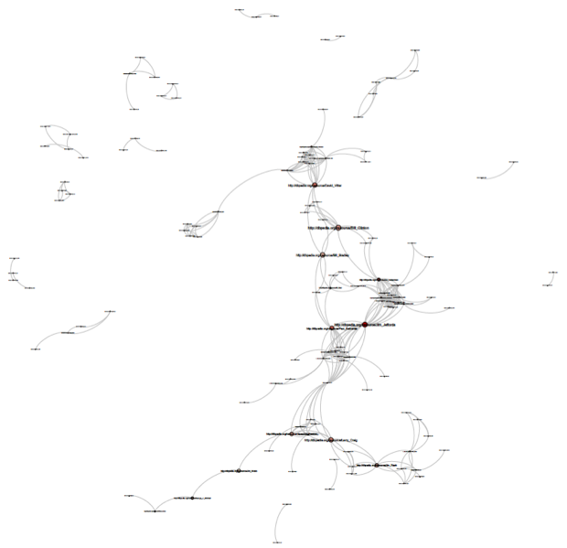
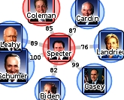
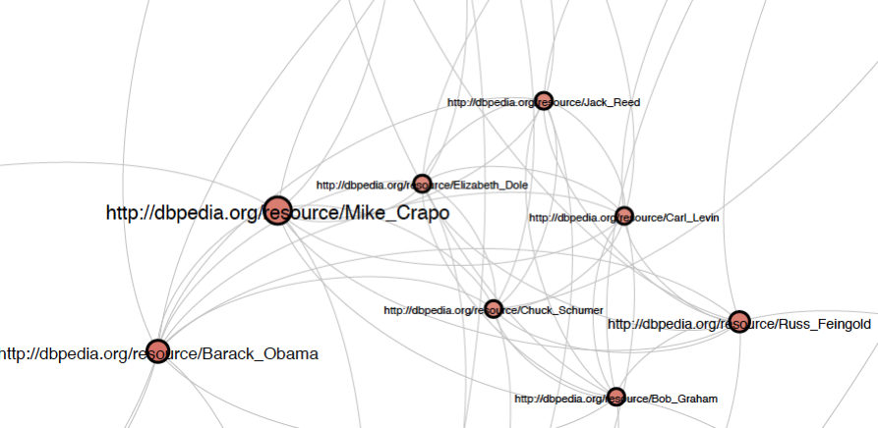
Many Networks Are Possible for the Same Entities
TouchGraph's visualization of senator co-sponsorship patterns in the 110th congress shows that he has acting like a democrat for years.
http://www.touchgraph.com/news
US Senators that share an Alma Mater

Slide 27
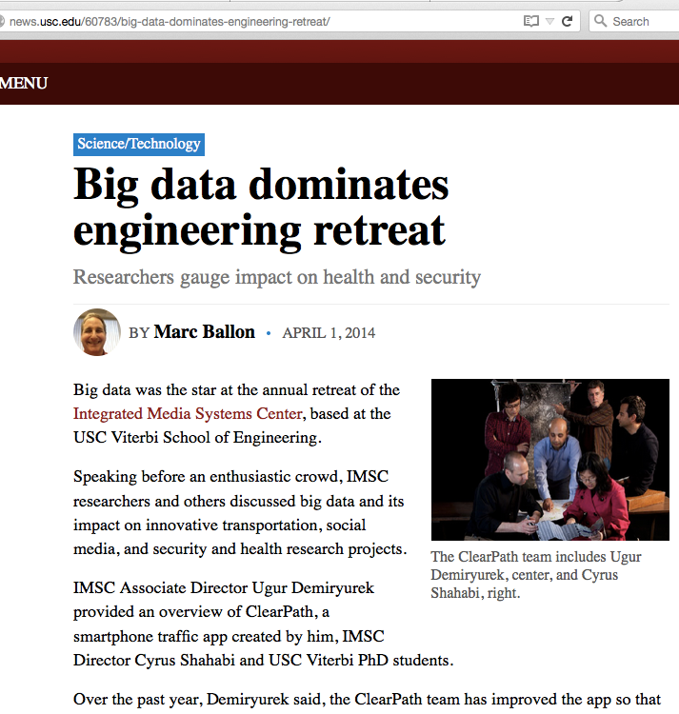
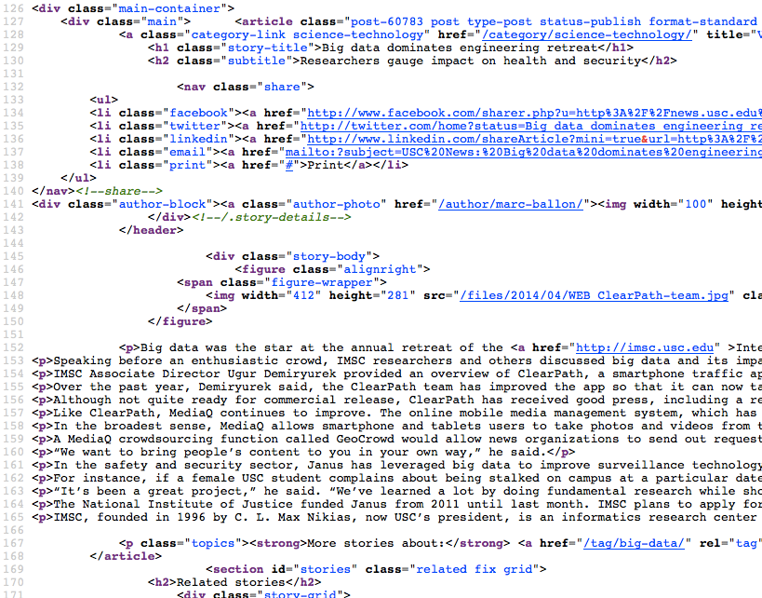
Text Data
“View page source”
http://news.usc.edu/60783/big-data-dominates-engineering-retreat/

Slide 28
Text Data with HTML Markup
“View page source”
http://news.usc.edu/60783/big-data-dominates-engineering-retreat/

Slide 29
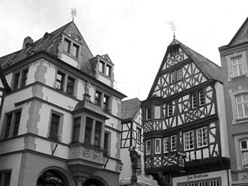
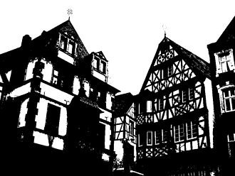
Multimedia Data: Images
What you see:
windows, houses, roofs,
What the computer sees:
pixels, lines, blobs,…
https://en.wikipedia.org/wiki/Otsu%27s_method

Slide 30
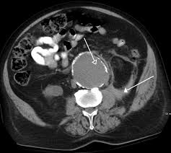
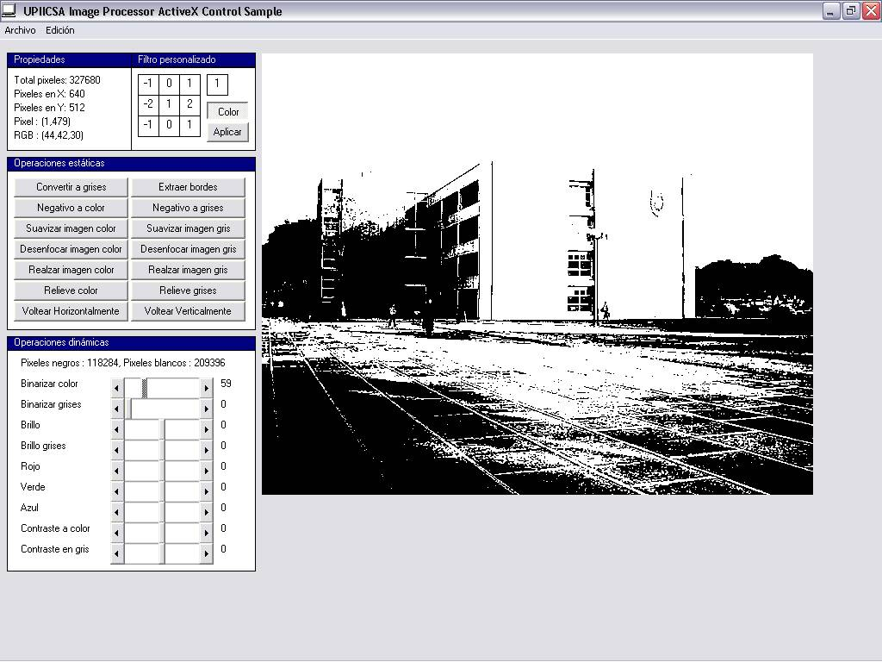
Image “Segmentation”: Finding Lines in an Image
https://en.wikipedia.org/?title=Image_processing#/media/File:Imagen_binaria.jpg
https://en.wikipedia.org/?title=Image_processing#/media/File:Imagen_binaria.jpg

Slide 31
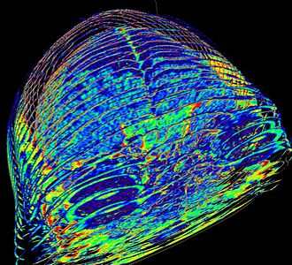
Multimedia Data: 3D Images (“Volumes”)
https://en.wikipedia.org/wiki/3D_scanner#/media/File:CT_Scan_of_Dale_Mahalko%27s_brain-skull.jpg

Slide 32
https://www.youtube.com/watch?v=lhfPi9GwD6M http://datab.us/lhfPi9GwD6M http://datab.us/GdPeydPbM0g#San%20Marco
http://grail.cs.washington.edu/projects/rome/rome_paper.pdf

Slide 33
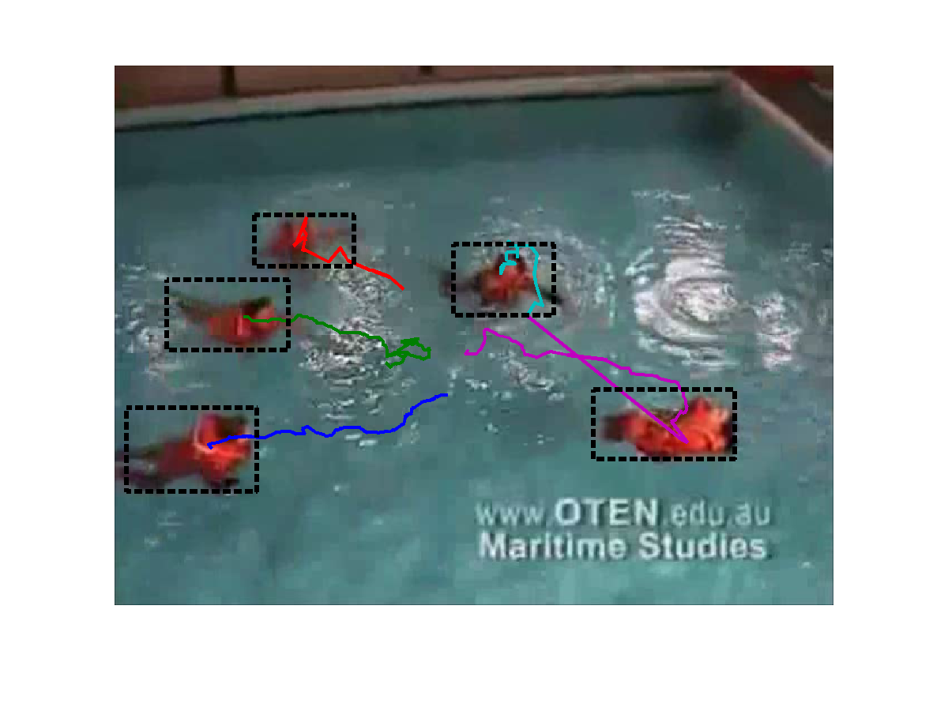
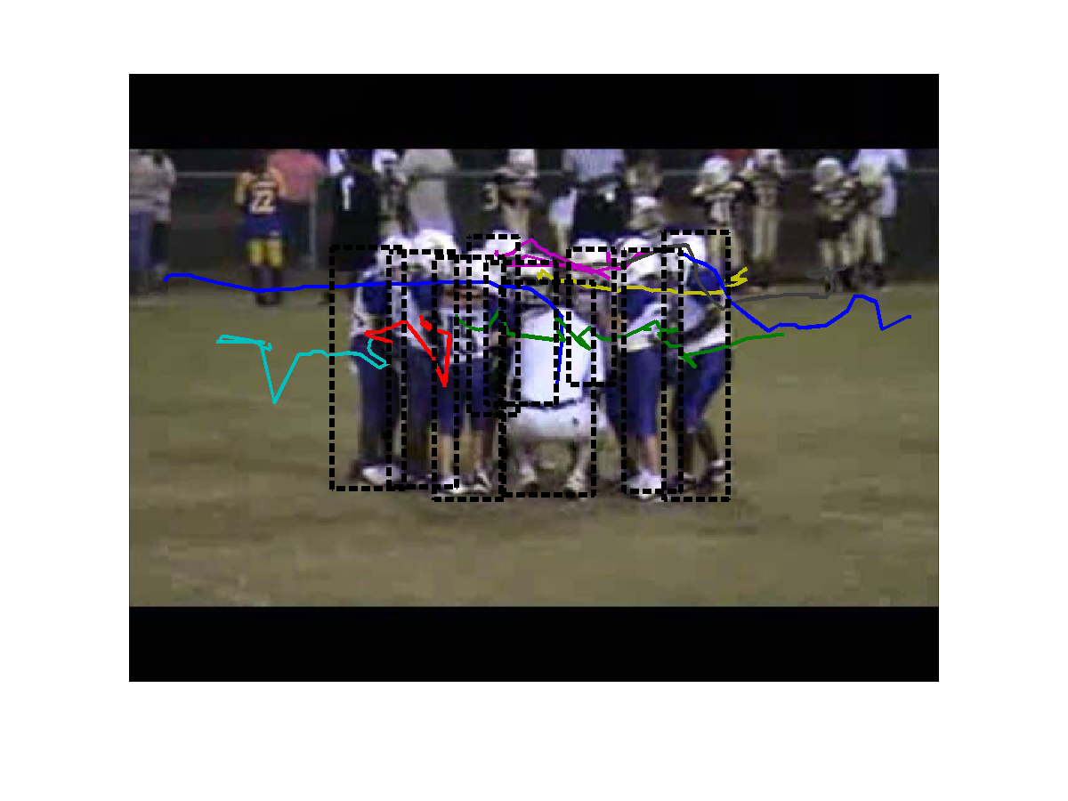
Multimedia Data: Video
http://research.sethi.org/ricky/datasets/

Slide 34
4. Common Data Terms

Slide 35
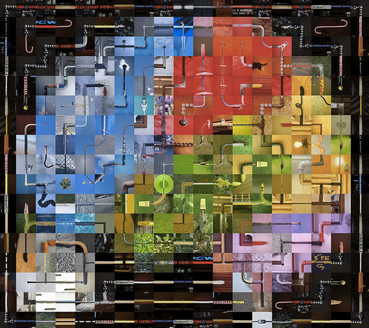
Common Data Terms
Private and sensitive data
Metadata versus data
Unstructured vs structured data
Databases
Data silos
Born digital
Data quality
Data cleaning
Raw data
Open data
“Big data”
https://www.flickr.com/photos/genista/3432987963

Slide 36
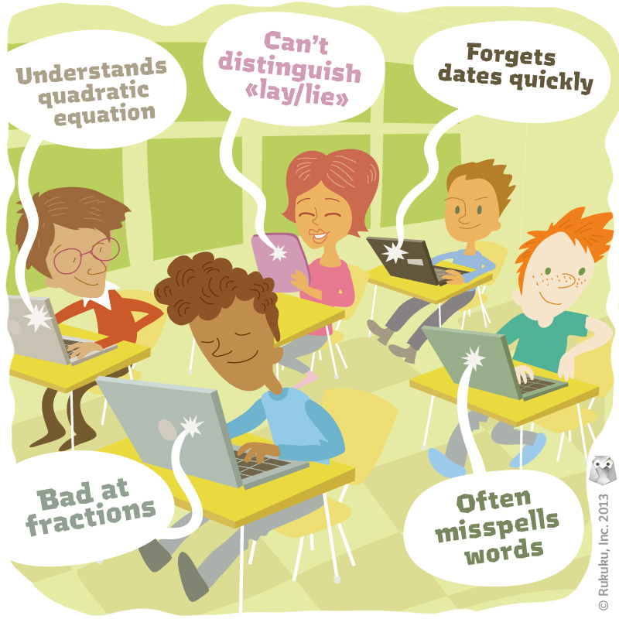
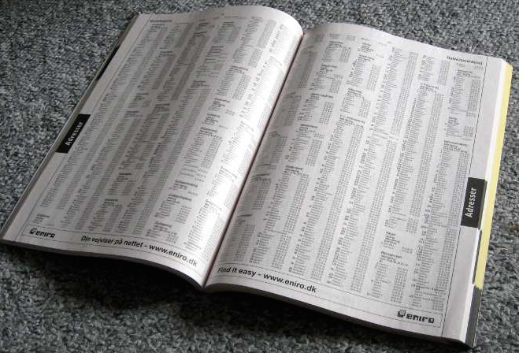
Private and Sensitive Data
http://www.rukuku.com/blog/wp-content/uploads/student-data-and-personalization.jpg
http://www.crimeoff24.com/?p=4869
https://en.wikipedia.org/?title=Telephone_directory#/media/File:Telefonbog_ubt-1.JPG

Slide 37
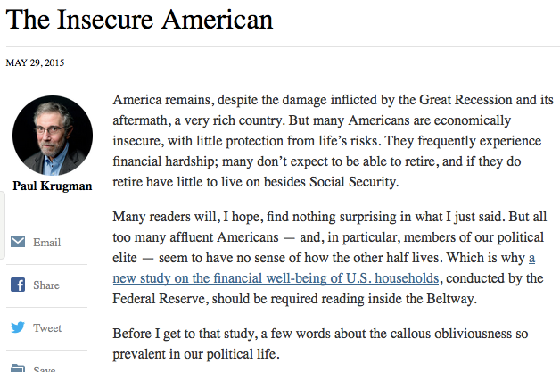
Metadata versus Data
Publisher: New York Times
Publication date: May 29, 2015
Author: Paul Krugman
Title: The Insecure American

Slide 38


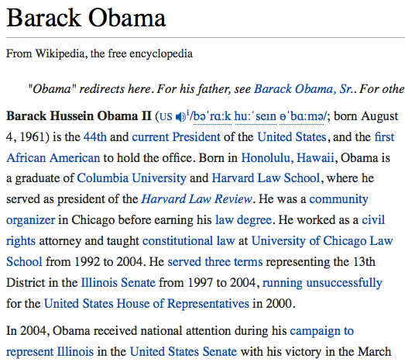
Unstructured vs Structured Data

Slide 39
Structuring Data with XML Markup
<observation>
<date>29 January 2015</date>
<temperature>
<value>59</value>
<unit>F</unit>
</temperature>
<activity>Not many birds observed today. Some squirrels were
running around but not as many as other days. A
raccoon came in sight briefly.
</activity>
</observation>

Slide 40
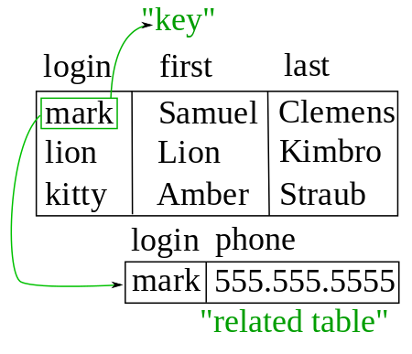
Databases
Tabular organization of data
Efficient “queries”
Relational databases: relations across tables
“Key” as the unique identifier of objects across tables

Slide 41
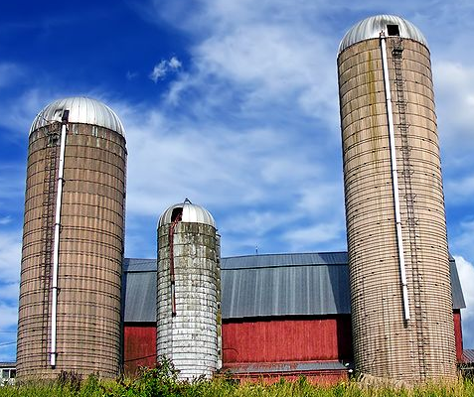
Data Silos
Hard to get data out
Hard to integrate data across silos
Examples:
Social sites
Electronic patient records
https://commons.wikimedia.org/wiki/File:Allegany_Township_silos.jpg

Slide 42

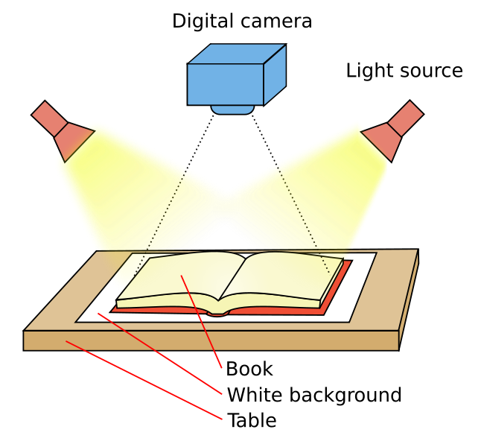
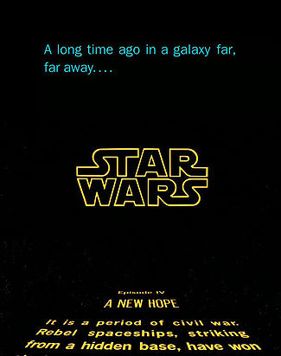
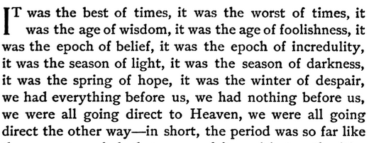
Data “Born Digital”
Originally recorded or created in digital form
https://commons.wikimedia.org/wiki/File:Book_scanner.svg#/media/File:Book_scanner.svg

Slide 43
Data Quality
http://query.nytimes.com/mem/archive-free/pdf?res=9D01EFD91F3AEF3BBC4950DFB467838E669FDE

Slide 44
Data Cleaning
Course ID | Faculty Name | Semester Offered | Open
549 | A. Gold | Fall 2015 | Yes
533 | D. Garcia | Spring 2015 | Open
556 | P. Peters | Spring 2015 | Y
521 | J. Smith | Fall 2017 | Open
Joseph Smith or Jane Smith?
Errors (maybe)
Inconsistent formats

Slide 45
Data Cleaning to the Extreme…
Patient ID | Age | Smoker?
549 | 45 | Occasionally as a teen
533 | 55 | Never before lunch
556 | 43 | Two packs a day
521 | 78 | Quit 3 years ago
Requires a lot of work to be usable

Slide 46
Raw Data
Raw data is newly collected data before any kind of cleaning or pre-processing. It typically has errors and missing values, and may not be in a format that is easy to use with other data.
Course ID | Students Registered | Semester Offered | Open
549 | 15 | Fall 2015 | Yes
533 | 50 | Spring 2015 | Open
556 | 200 |  | Y
521 | 5000 | Fall 2017 | Open

Slide 47

Open Data
Data freely available to anyone, may have restrictions (through an open data use license)
Open science data
Open government data
https://www.flickr.com/photos/opensourceway/5538036200/in/photostream/

Slide 48
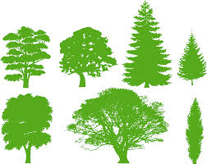


“Big Data”
Volume: very large quantities
Variety: very diverse in nature
eg. from different sensors
Velocity: very fast collection rates
https://pixabay.com/en/whale-mammal-ocean-silhouette-308732/
https://pixabay.com/en/trees-silhouette-variety-309435/
https://pixabay.com/en/cheetah-animal-fast-run-running-312034/

Slide 49

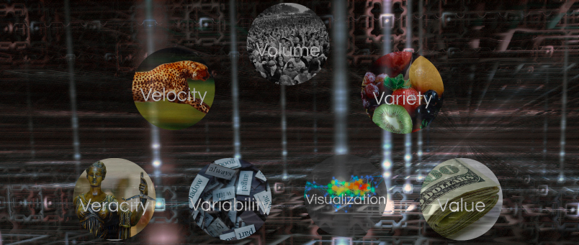
The Many “Vs” of Big Data
Volume
Velocity
Variety
Veracity
Value
Volume
Velocity
Variety
Veracity
Variability
Visualization
Value
https://datafloq.com/read/3vs-sufficient-describe-big-data/166

Slide 50
5. A Practical Example: Collecting Field Data in Geosciences

Slide 51
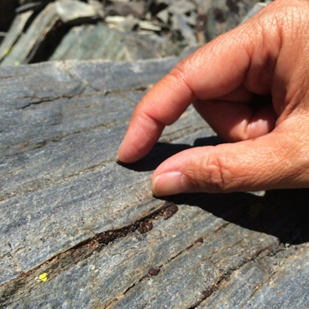

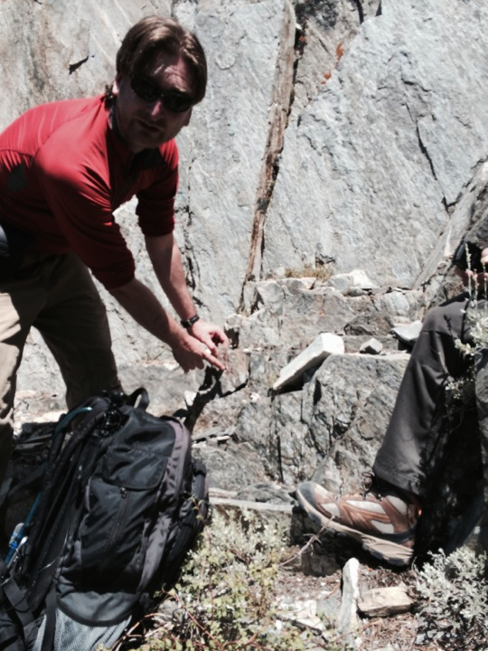
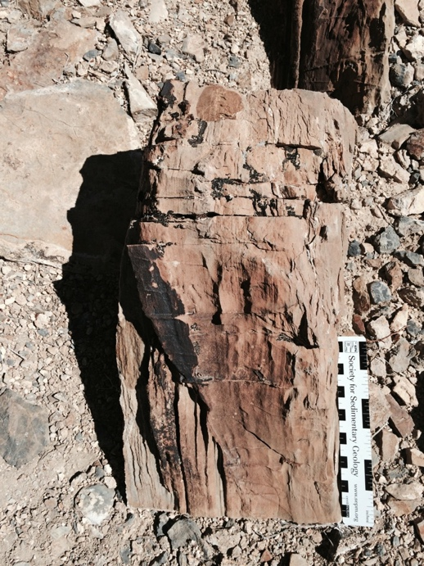
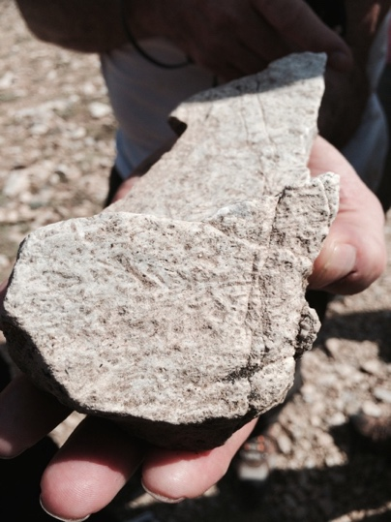
Collecting Physical Samples and Field Observations

Slide 52
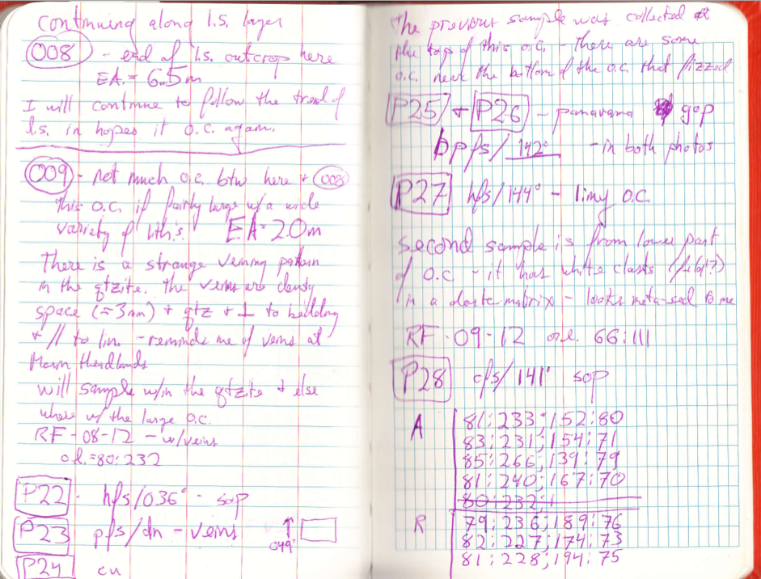
A Scientist’s Field Notebook

Slide 53
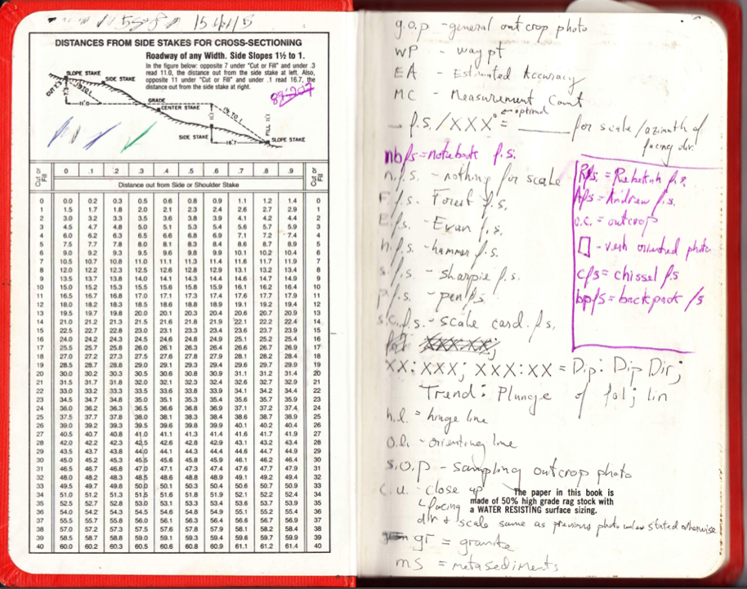
Idiosyncratic Notations

Slide 54
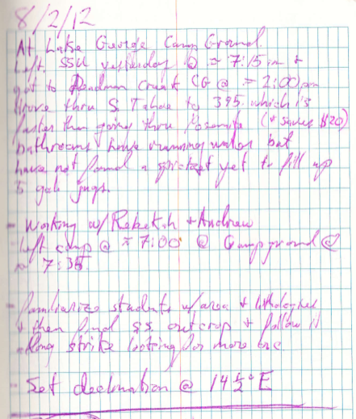
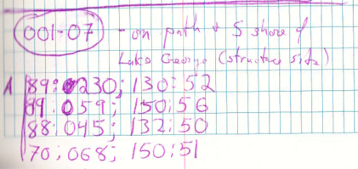
Notes about Location

Slide 55
Notes about Pictures

Slide 56
Notes About a Rock Sample

Slide 57
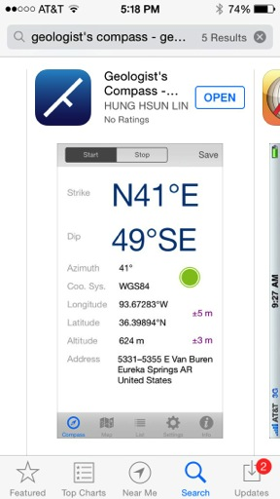
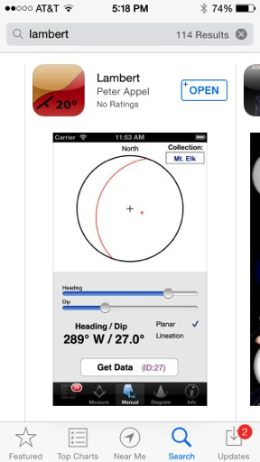
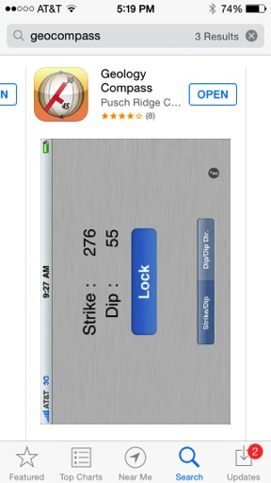
Born-Digital Data

